Slide 1
exceptions
Numbers
and
Strings

Slide 2
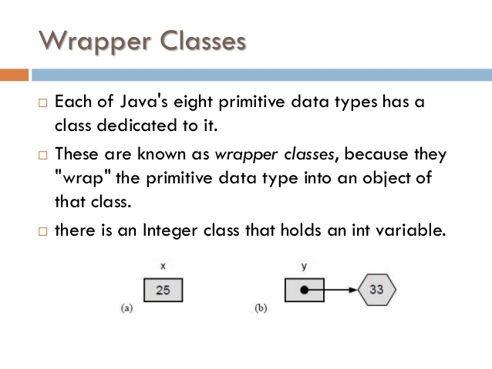
exceptions

Slide 3
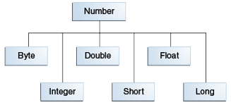
exceptions
Primitives and Wrapper Classes.
Advantages of using Wrapper classes over primitives.
As an argument of a method that expects an object
To use constants defined by the class, such as MIN_VALUE and MAX_VALUE.
To use class methods for converting values to and from other primitive types,

Slide 4
exceptions
Methods implemented by all subclasses of Number

Slide 5
exceptions
Methods implemented by all subclasses of Number……
https://docs.oracle.com/javase/tutorial/java/data/numberclasses.html

Slide 6
exceptions
Formatting Numeric Print Output
System.out that you have been using happens to be a PrintStream object.
[java.io.PrintStream] public PrintStream format(String format, Object... args)
Ex:
System.out.format("The value of " + "the float variable is " +
"%f, while the value of the " + "integer variable is %d, " +
"and the string is %s", floatVar, intVar, stringVar);
To print numbers in the French system (where a comma is used in place of the decimal place in the English representation of floating point numbers), for example, you would use:
System.out.format(Locale.FRANCE,
"The value of the float " + "variable is %f, while the " +
"value of the integer variable " + "is %d, and the string is %s%n",
floatVar, intVar, stringVar);
Lab17.1: Demonstration of using Number formatter:

Slide 7
exceptions
Formatting Numeric Print Output………
Use java.text.DecimalFormat class
To control the display of leading and trailing zeros.
prefixes and suffixes.
Grouping (thousands) separators, and the decimal separator.
customFormat("###,###.###", 123456.789);
static public void customFormat(String pattern, double value ) {
DecimalFormat myFormatter = new DecimalFormat(pattern);
String output = myFormatter.format(value);
System.out.println(value + " " + pattern + " " + output);
}
Lab17.2: Demonstration of using Decimal formatter

Slide 8
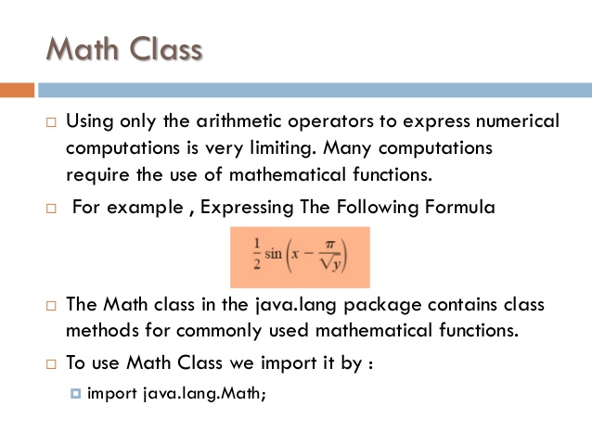
exceptions

Slide 9
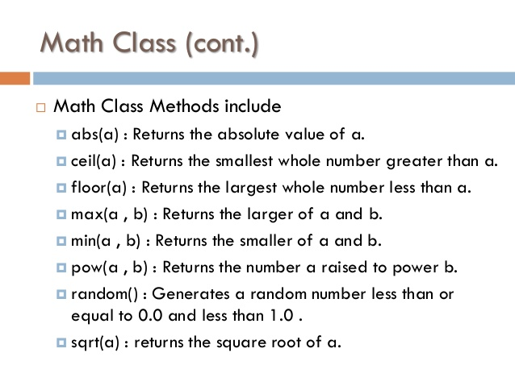
exceptions

Slide 10
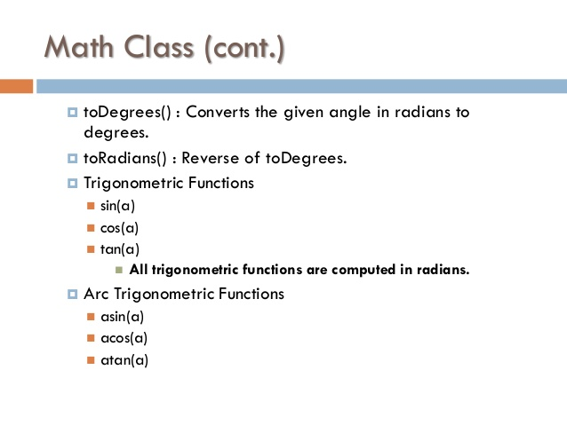
exceptions
Lab17.3: Demonstration of using Math functions.
Lab17.4: Demonstration of using Math exponential functions
Lab17.5: Demonstration of using Math trigonometric functions:
Lab17.6: Demonstration of adding numbers passed as arguments:

Slide 11
Character Examples:
char ch = 'a';
// Unicode for uppercase Greek omega character
char uniChar = '\u03A9';
// an array of chars
char[] charArray = { 'a', 'b', 'c', 'd', 'e' };
The Java programming language provides a wrapper class that "wraps" the char in a Character object for this purpose

Slide 12
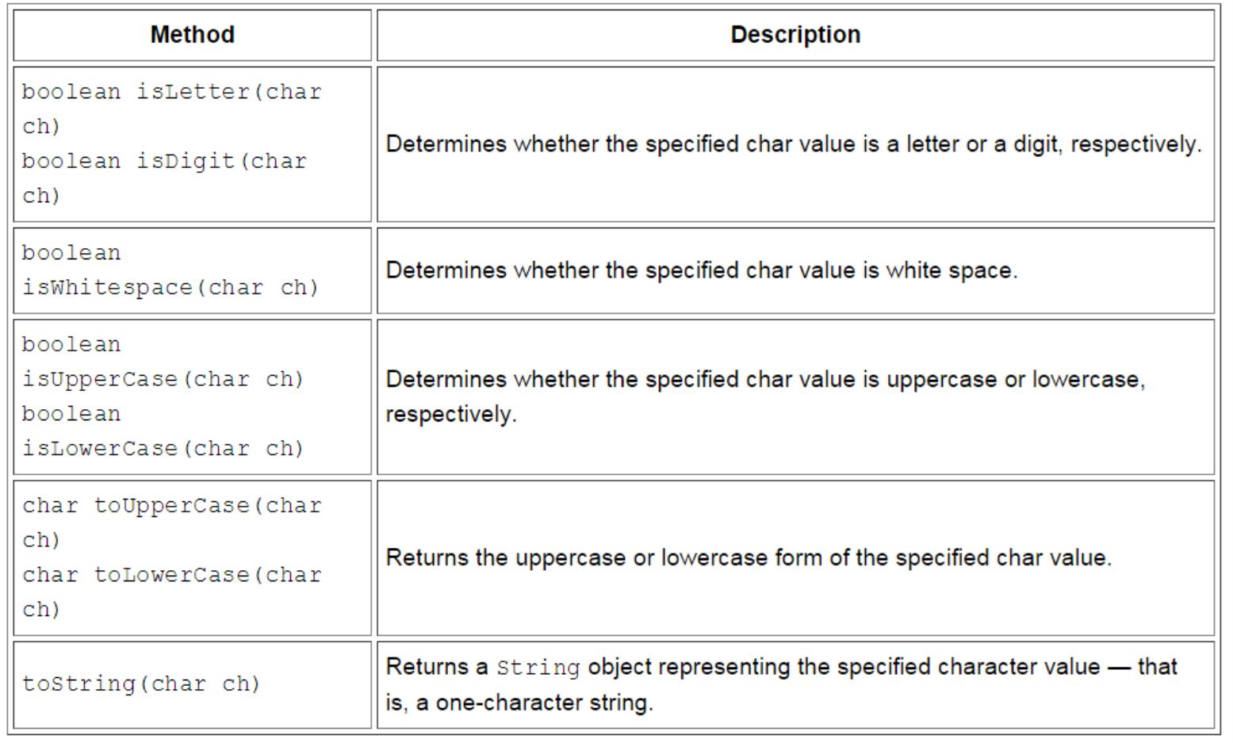
exceptions
Character API

Slide 13
exceptions
Escape Sequences
A character preceded by a backslash (\) is an escape sequence and has special meaning to the compiler.

Slide 14
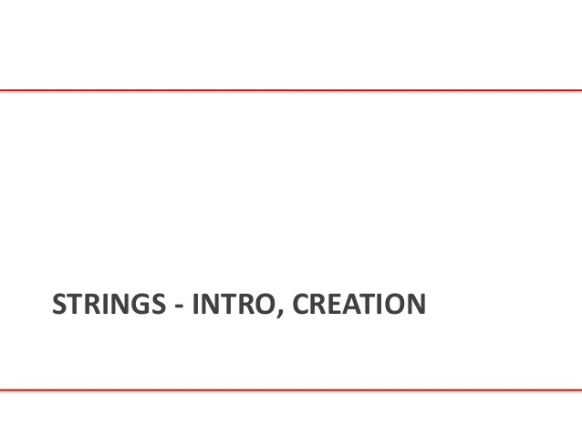
exceptions

Slide 15
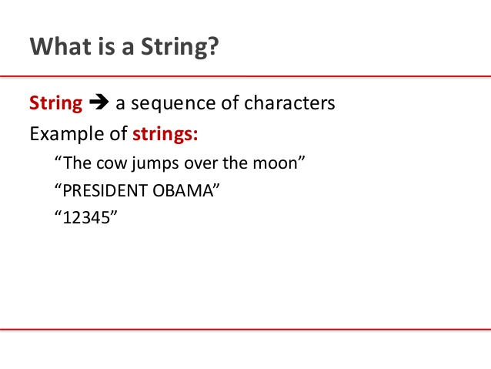
exceptions

Slide 16
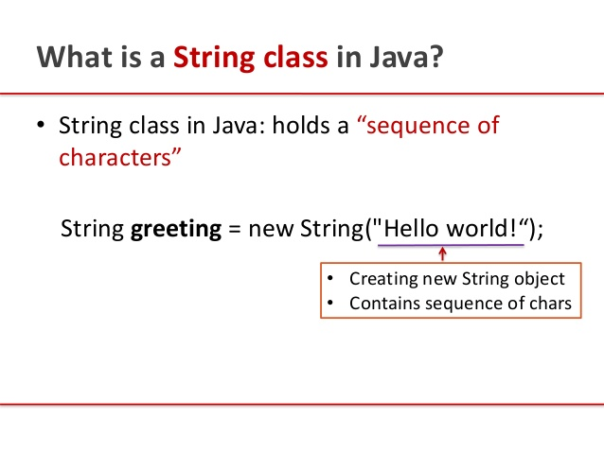
exceptions

Slide 17
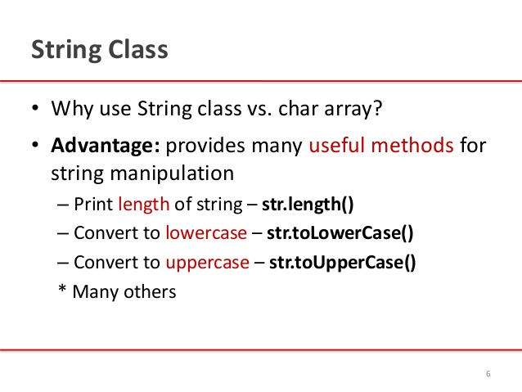
exceptions

Slide 18
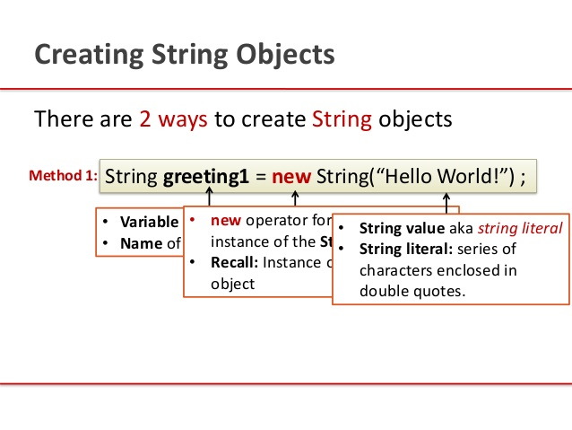
exceptions

Slide 19
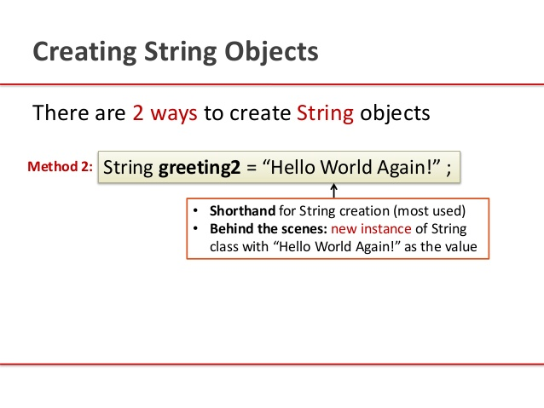
exceptions

Slide 20
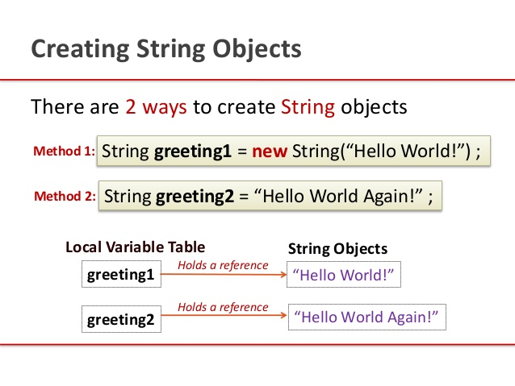
exceptions

Slide 21
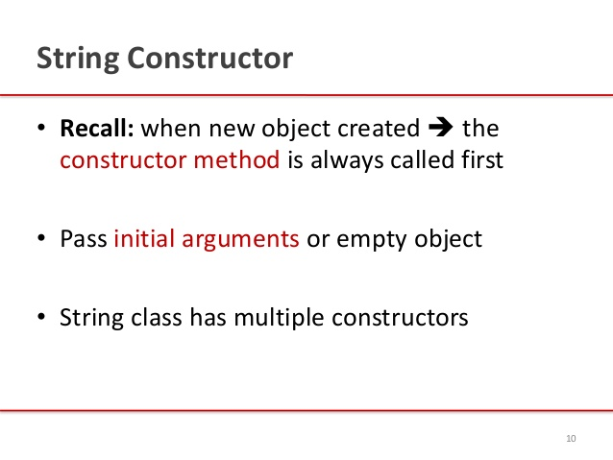
exceptions

Slide 22
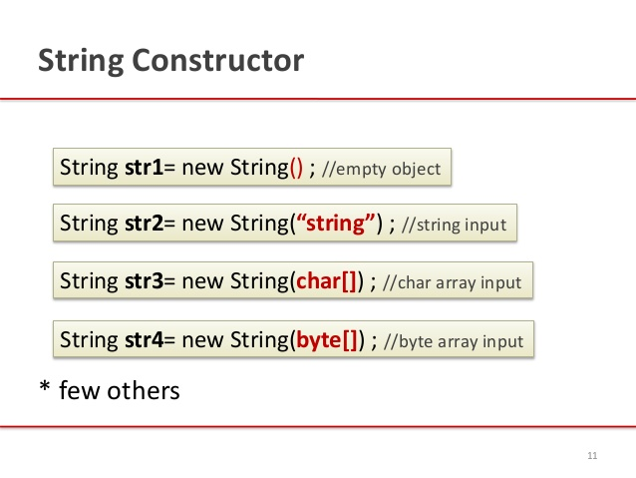
exceptions

Slide 23
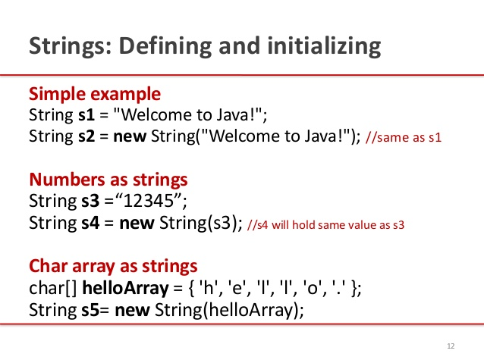
exceptions

Slide 24
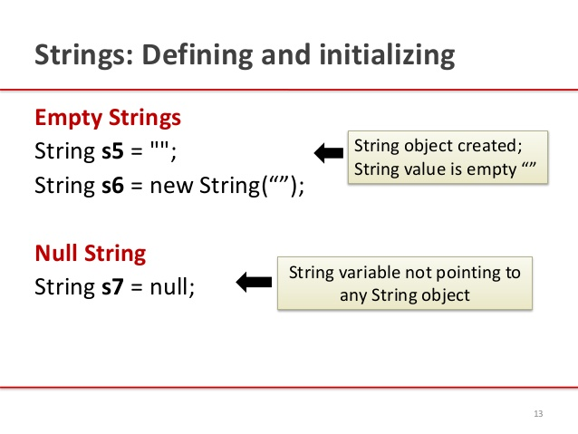
exceptions

Slide 25
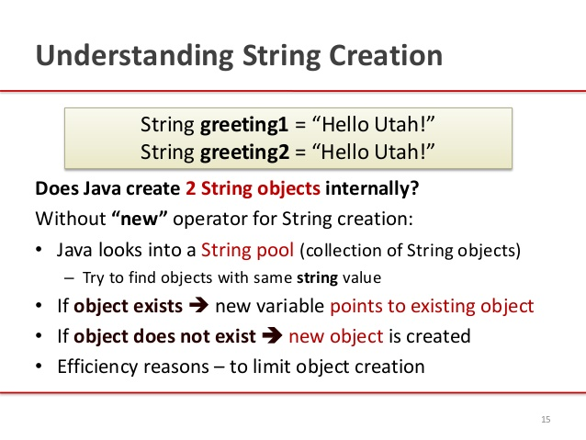
exceptions

Slide 26
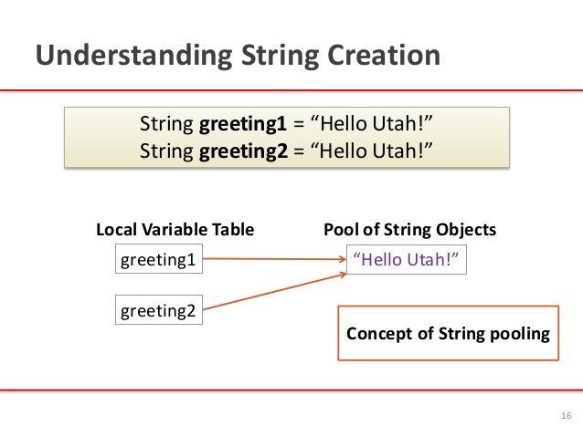
exceptions

Slide 27
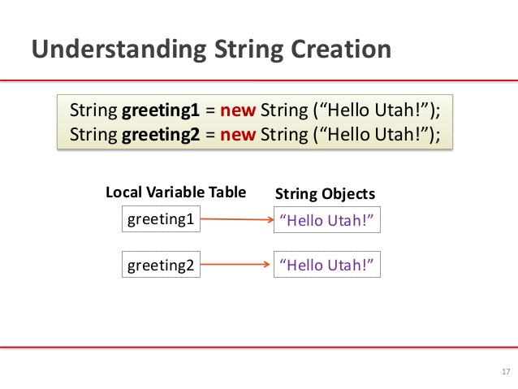
exceptions

Slide 28
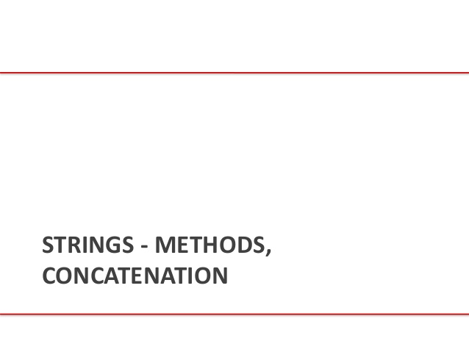
exceptions

Slide 29
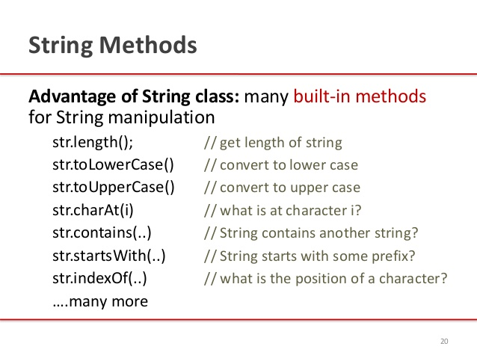
exceptions

Slide 30
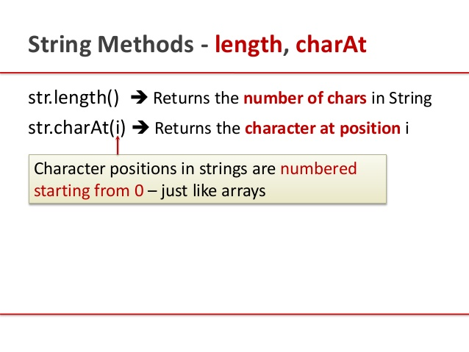
exceptions

Slide 31
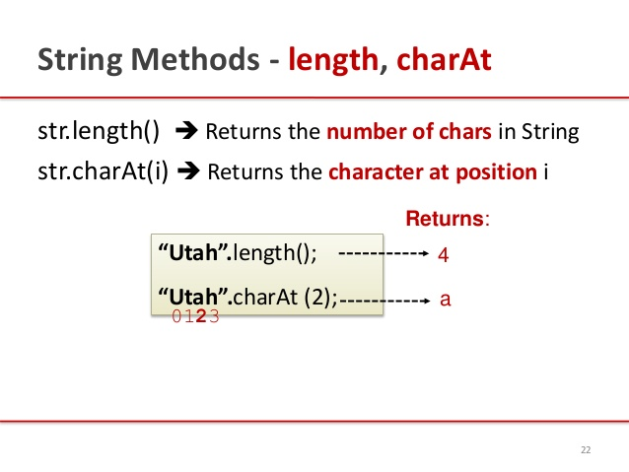
exceptions

Slide 32
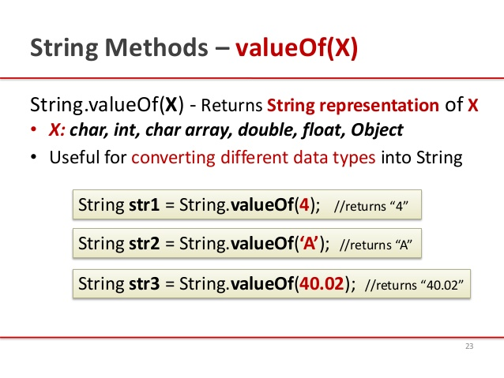
exceptions

Slide 33
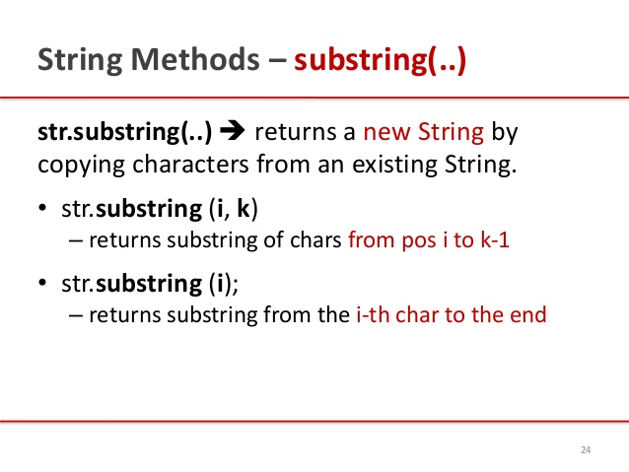
exceptions

Slide 34
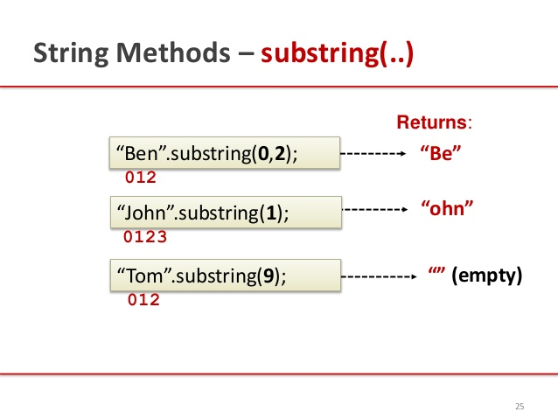
exceptions

Slide 35
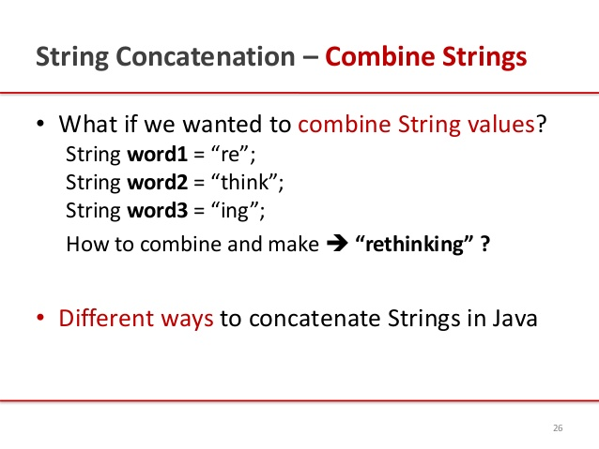
exceptions

Slide 36
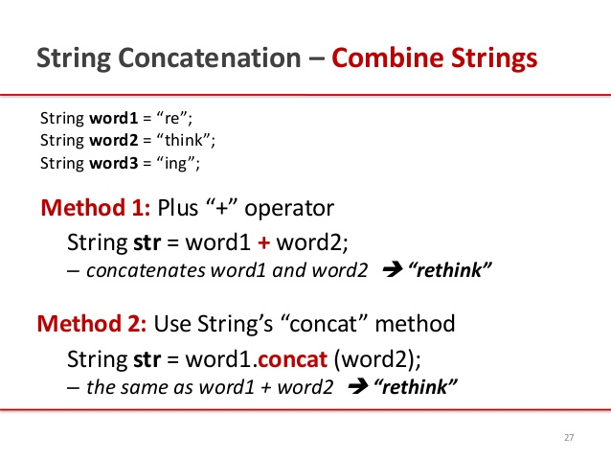
exceptions

Slide 37
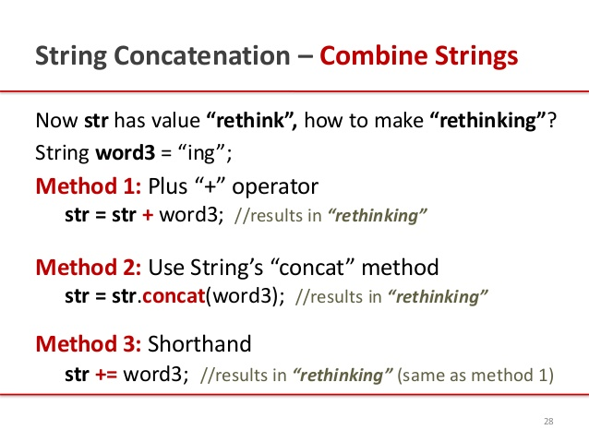
exceptions

Slide 38
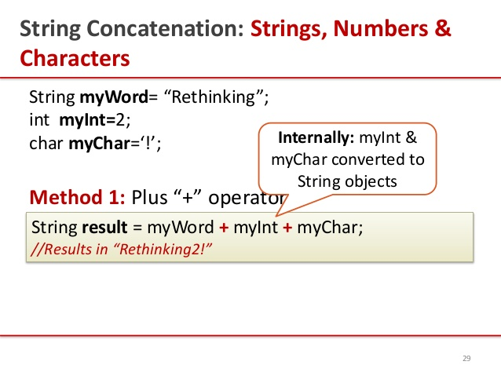
exceptions

Slide 39
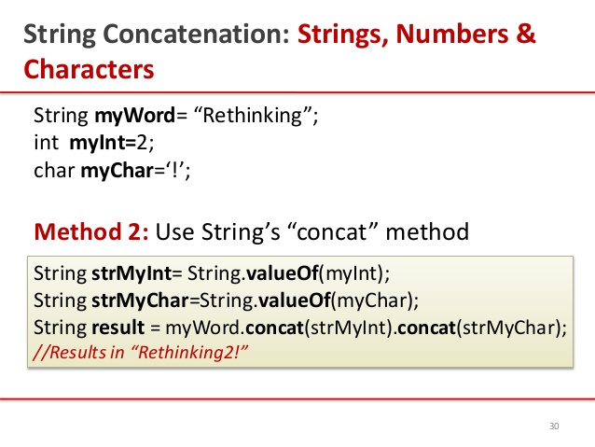
exceptions

Slide 40
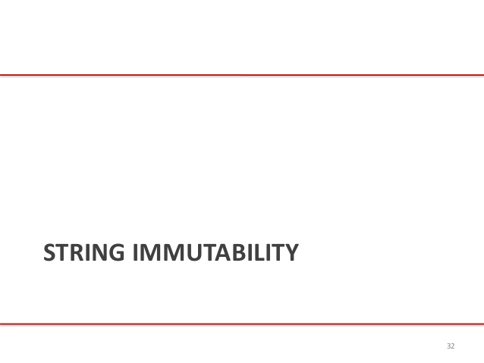
exceptions

Slide 41
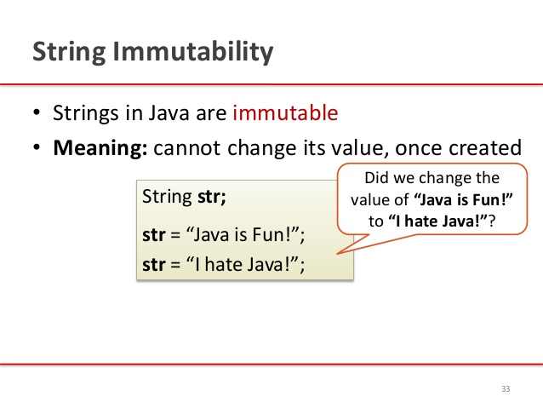
exceptions

Slide 42
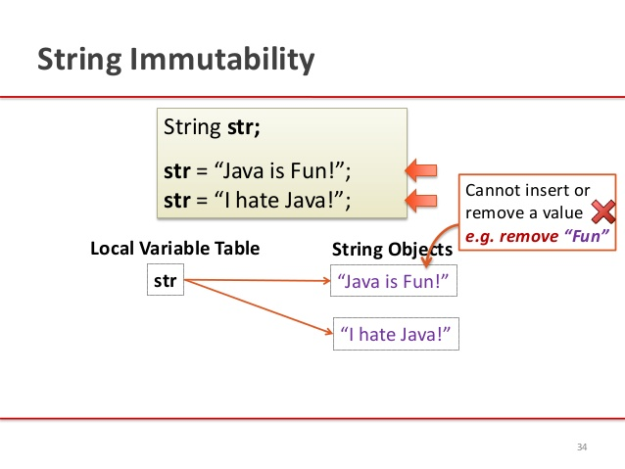
exceptions

Slide 43
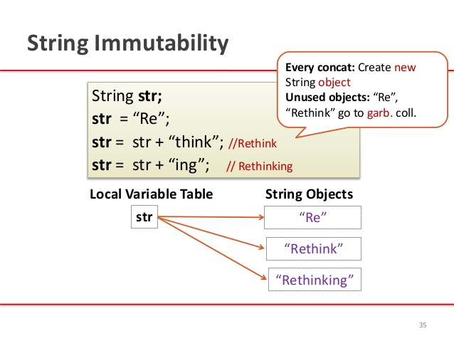
exceptions

Slide 44
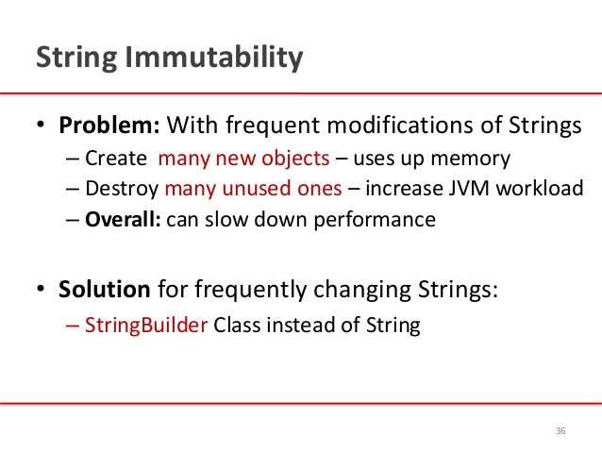
exceptions

Slide 45
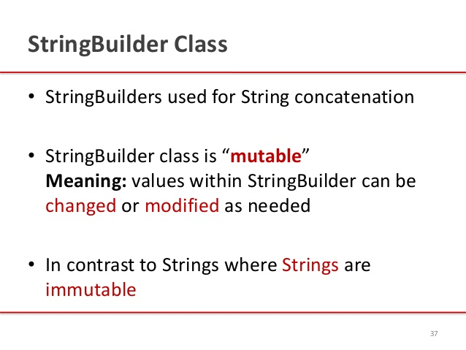
exceptions

Slide 46
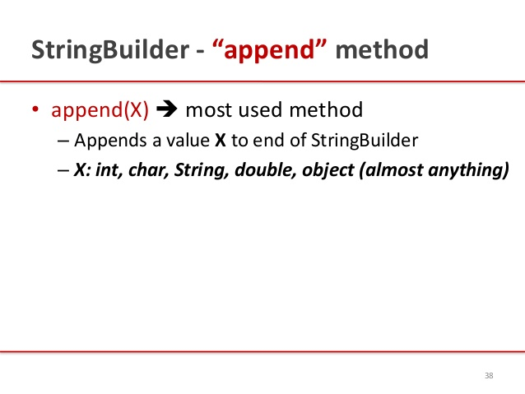
exceptions

Slide 47
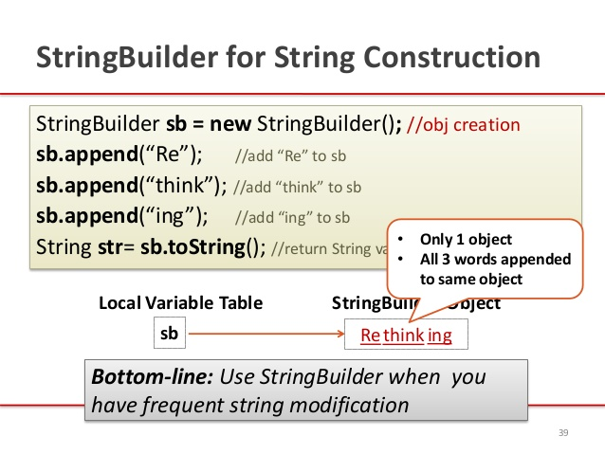
exceptions

Slide 48
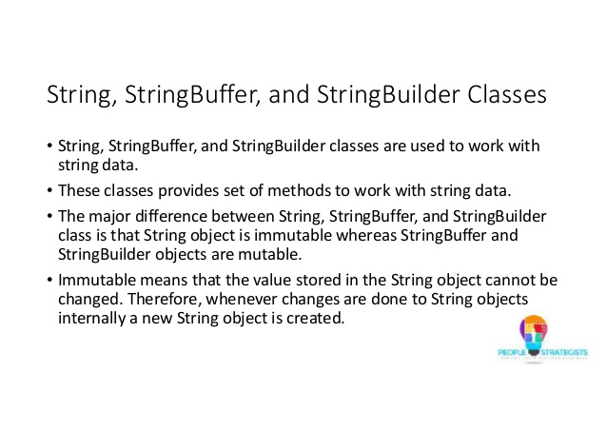
exceptions

Slide 49
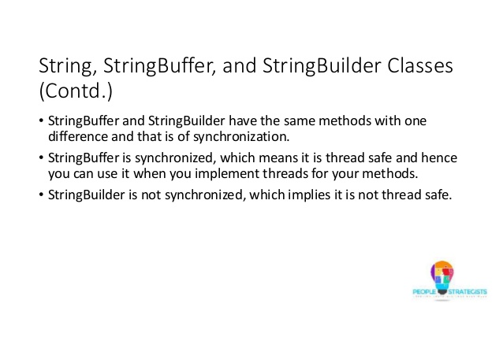
exceptions

Slide 50
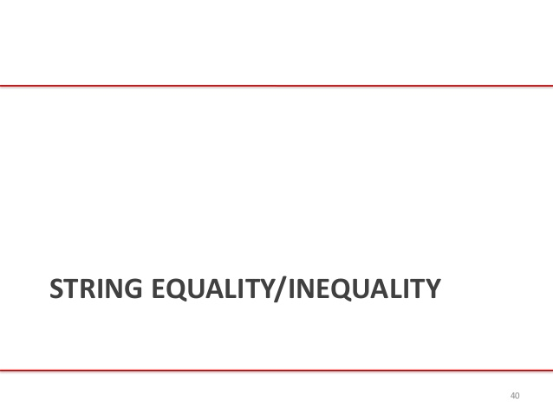
exceptions

Slide 51
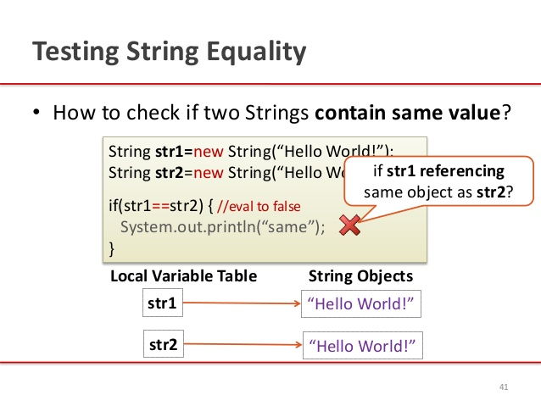
exceptions

Slide 52
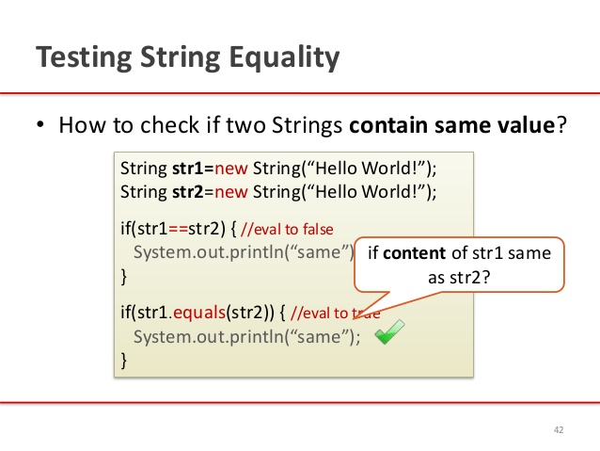
exceptions

Slide 53
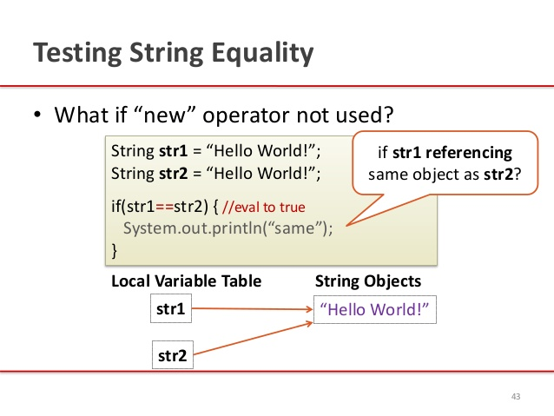
exceptions

Slide 54
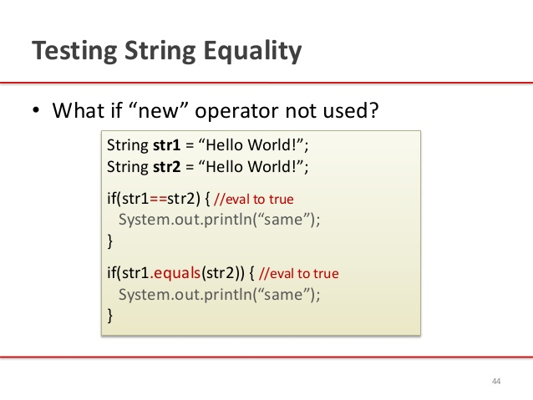
exceptions

Slide 55
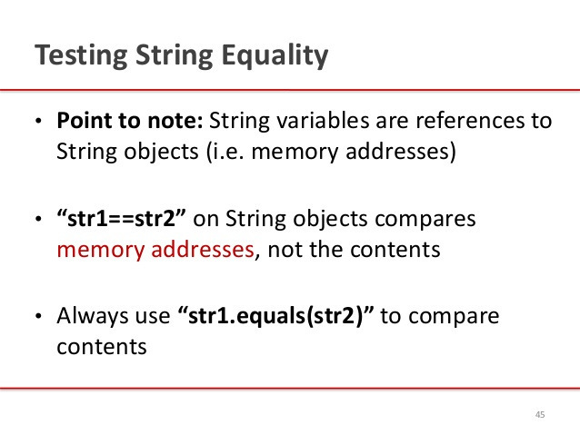
exceptions
Lab17.7:
Demonstration of String functions:
Lab17.8: Demonstration of String functions with palindrome example:
Lab17.9: Demonstration of converting string to numbers:
Lab17.10: Demonstration of string search functions:

Slide 56

exceptions

Slide 57
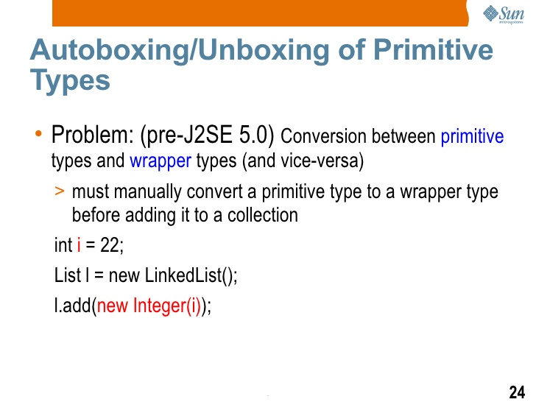
exceptions

Slide 58
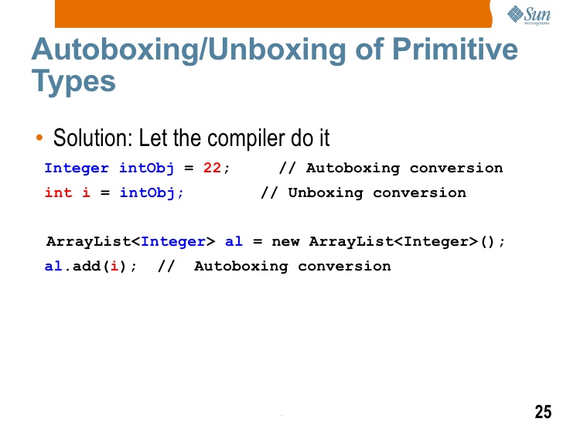
exceptions

Slide 59

exceptions
Autoboxing/Unboxing:
Examples:
Autobxing:
public static int sumEven(List<Integer> li) {
int sum = 0;
for (Integer i: li)
if (i % 2 == 0)
sum += i;
return sum;
}
Unboxing
Integer i = new Integer(-8);
int absVal = absoluteValue(i);
System.out.println("absolute value of " + i + " = " + absVal);
Lab17.11: Demonstration of Unboxing:

Slide 60
exceptions

Slide 61

exceptions

Slide 62

exceptions

Slide 63

exceptions

Slide 64

exceptions

Slide 65

exceptions

Slide 66
References
http://www.slideshare.net/KavitaGanesan/is-66154415-kavitaganesanv2 - Strings
http://www.slideshare.net/PeopleStrategists/java-day4-50374926 - Autoboxing

Slide 67
exceptions

Slide 68
exceptions

Slide 69
exceptions

Slide 70
exceptions

Slide 71
Java - miscellaneous
Type Comparison Operator instanceof
The instanceof operator compares an object to a specified type.
You can use it to test if an object is an instance of a class, an instance of a subclass, or an instance of a class that implements a particular interface
Classes implementing interfaces
class MyClass extends MySuperClass implements YourInterface {
// field, constructor, and
// method declarations
}

Slide 72
Java - miscellaneous
Varargs – Specifying Arbitrary number of arguments
public Polygon polygonFrom(Point... corners) {
int numberOfSides = corners.length;
double squareOfSide1, lengthOfSide1;
squareOfSide1 = (corners[1].x - corners[0].x)
* (corners[1].x - corners[0].x)
+ (corners[1].y - corners[0].y)
* (corners[1].y - corners[0].y);
lengthOfSide1 = Math.sqrt(squareOfSide1);
// more method body code follows that creates and returns a
// polygon connecting the Points
}
You will most commonly see varargs with the printing methods; for example, this printf method:
public PrintStream printf(String format, Object... args)
allows you to print an arbitrary number of objects. It can be called like this:
System.out.printf("%s: %d, %s%n", name, idnum, address);

Slide 73

Java - miscellaneous
Returning a Class or Interface
When a method uses a class name as its return type the class of the type of the returned object must be either a subclass of, or the exact class of, the return type.
public Number returnANumber() {
...
}
The returnANumber method can return an ImaginaryNumber but not an Object. ImaginaryNumber is a Number because it's a subclass of Number. However, an Object is not necessarily a Number — it could be a String or another type

Slide 74
Advanced java
Garbage collection
JDBC
Lambda expressions
Annotations
Aggregate operations on collection using Lambarda expression.
Java streaming
Blocking queue
Aggregate operations
Autoboxing and unboxing

Slide 75
https://docs.oracle.com/javase/tutorial/reallybigindex.html
http://www.slideshare.net/EdurekaIN/java-class-3
http://www.slideshare.net/abdurrehmanabdurrehman391/variables-and-data-types-by-sir-khalid
http://www.slideshare.net/abdurrehmanabdurrehman391/java-advancedoop
http://www.slideshare.net/MindfireSolutions/java-garbage-collection-how-it-works?next_slideshow=1
http://www.slideshare.net/arnold7490/unit-4-java
http://www.slideshare.net/arnold7490/unit-3-java?next_slideshow=1
http://www.slideshare.net/tushardesarda/java-tutorial-3
http://www.slideshare.net/muralidhar9e/java-exception-handling-ppt
http://www.slideshare.net/emprovise/2-javabasics
http://www.slideshare.net/AllanHuang/java-new-evolution
http://www.slideshare.net/antonkeks/4-collections
http://www.slideshare.net/andreaiacono/java8-39841939 - Java8 features
http://www.slideshare.net/AbhishekKhune/07-java-collection
http://www.slideshare.net/shahjahan786/generics-27960064 - Generics
http://www.slideshare.net/caroljmcdonald/java-generics-2485138?next_slideshow=1

Slide 76
http://www.slideshare.net/KavitaGanesan/is-66154415-kavitaganesanv2 - Strings

